Slide 1
SMOOTHING FREQUENCY DOMAIN
PRESENTED BY :
K PAVITRA
R8B74

Slide 2
CONTENTS:-
Ideal Low Pass Filter
Gaussian Low Pass Filter
Butterworth Low Pass Filter

Slide 3
Smoothing in Frequency Domain
Smoothing in the frequency domain is a technique used in digital image processing to reduce noise and remove fine details by suppressing high-frequency components of an image.
An image contains:
Low-frequency components → Smooth areas (slow intensity changes)
High-frequency components → Edges, sharp details, noise (rapid intensity changes)

Slide 4
Steps Involved :
1.Transform image to frequency domain
Apply Fourier Transform (FT) or Discrete Fourier Transform (DFT)
Practically done using Fast Fourier Transform (FFT)
2.Apply a Low-Pass Filter (LPF)
Multiply the frequency spectrum with a low-pass filter
This removes high-frequency components
3.Inverse Transform
Apply Inverse Fourier Transform to get the smoothed image back in spatial domain

Slide 5
DIFFERENT TYPES OF FILTERS :
IDEAL LOW PASS FILTER
GAUSSIAN LOW PASS FILTER
BUTTERWORTH LOW PASS FILTER

Slide 6
Ideal low pass filter :-
An Ideal Low Pass Filter (ILPF) allows low frequencies to pass and completely blocks high frequencies.
Low frequencies includes smooth areas of image High frequencies includes edges, sharp details, noise
So, Ideal low pass filter makes the image smooth and slightly blurred.
Why is it called “Ideal”?
Because it makes a perfect cut:
Inside a fixed radius → 100% passed
Outside that radius → 0% passed
There is no gradual change.

Slide 7

How It Works :-
Convert image into frequency domain (using FFT).
Draw a circle at the center (cutoff frequency $D_{0}).$
Keep values inside the circle.
Remove values outside the circle.
Convert back to spatial domain.
Usage of Ideal Low Pass Filters
Image Smoothing
Noise Reduction
Removal of Fine Details
Preprocessing in Image Processing

Slide 8
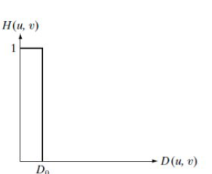
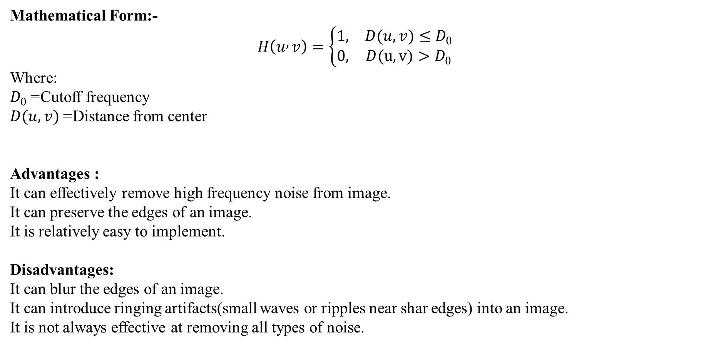
Mathematical Form:-
$$H\left(u , v\right)=\left\{\begin{matrix}1, & D(u,v)≤D_{0} \\ 0, & D(u,v)>D_{0}\end{matrix}\right.$$
Where:
$D_{0}$= Cutoff frequency
$D(u,v)$= Distance from center
Advantages :
It can effectively remove high frequency noise from image.
It can preserve the edges of an image.
It is relatively easy to implement.
Disadvantages:
It can blur the edges of an image.
It can introduce ringing artifacts(small waves or ripples near shar edges) into an image.
It is not always effective at removing all types of noise.

Slide 9
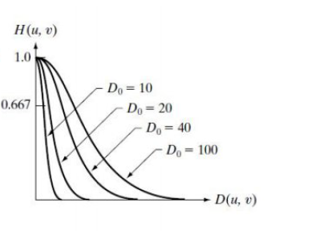
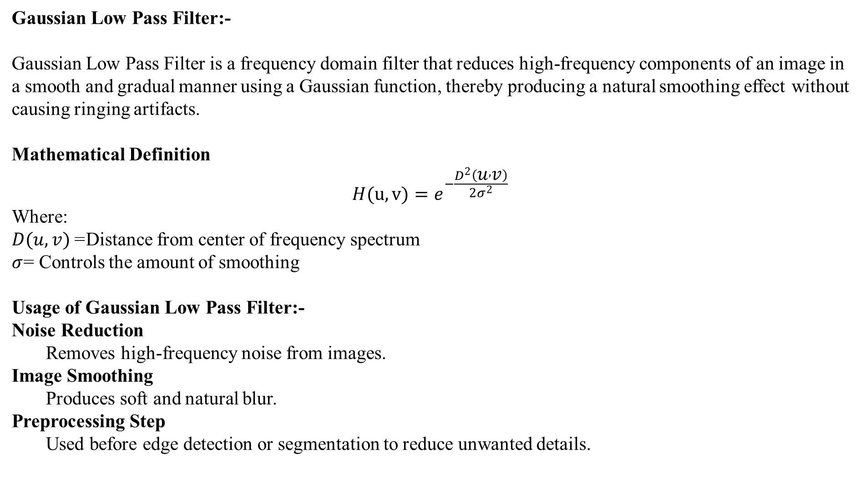
Gaussian Low Pass Filter:-
Gaussian Low Pass Filter is a frequency domain filter that reduces high-frequency components of an image in a smooth and gradual manner using a Gaussian function, thereby producing a natural smoothing effect without causing ringing artifacts.
Mathematical Definition
$$H(u,v)=e^{−\frac{D^{2}\left(u , v\right)}{2σ^{2}}}$$
Where:
$D(u,v)$= Distance from center of frequency spectrum
$σ$= Controls the amount of smoothing
Usage of Gaussian Low Pass Filter:-
Noise Reduction
Removes high-frequency noise from images.
Image Smoothing
Produces soft and natural blur.
Preprocessing Step
Used before edge detection or segmentation to reduce unwanted details.

Slide 10
Advantages
No Ringing Effect
Smooth transition avoids ripples near edges.
Natural Blurring
Produces visually pleasant smoothing.
Mathematically Simple
Based on Gaussian function.
Disadvantages
Blurs Edges
Important edge details may be lost.
Loss of Fine Details
Small features may disappear.
Computational Cost
Requires Fourier transform in frequency domain.

Slide 11
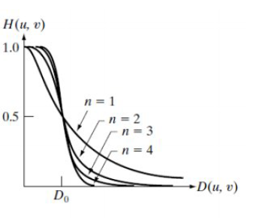
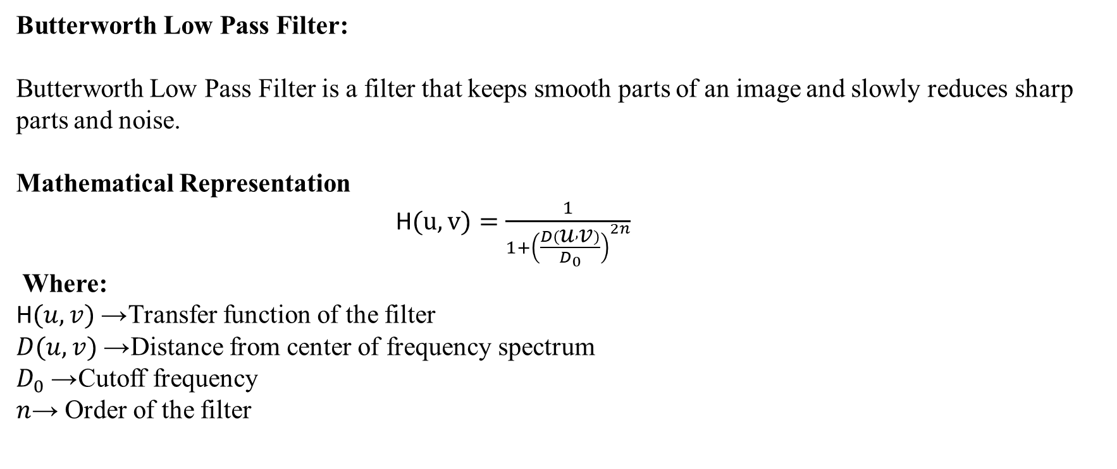
Butterworth Low Pass Filter:
Butterworth Low Pass Filter is a filter that keeps smooth parts of an image and slowly reduces sharp parts and noise.
Mathematical Representation
H$(u,v)=\frac{1}{1+{\left(\frac{D\left(u , v\right)}{D_{0}}\right)}^{2n}}$
Where:
H$(u,v)$→ Transfer function of the filter
$D(u,v)$→ Distance from center of frequency spectrum
$D_{0}$→ Cutoff frequency
$n$→ Order of the filter

Slide 12
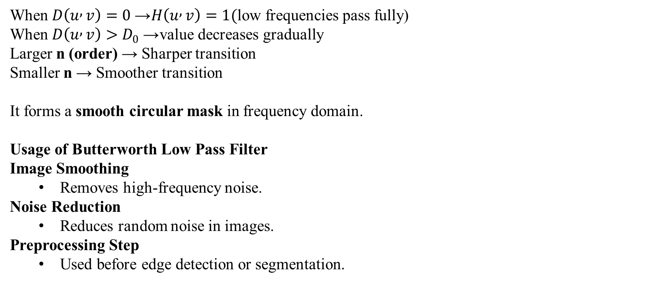
Important points about representation:-
When $D\left(u , v\right)=0$→ $H\left(u , v\right)=1($low frequencies pass fully) When $D\left(u , v\right)>D_{0}$→ value decreases gradually Larger n (order) → Sharper transition Smaller n → Smoother transition
It forms a smooth circular mask in frequency domain.
Usage of Butterworth Low Pass Filter
Image Smoothing
Removes high-frequency noise.
Noise Reduction
Reduces random noise in images.
Preprocessing Step
Used before edge detection or segmentation.

Slide 13
Advantages:
It can effectively remove high frequency noise from an image.
It can preserve the edges of an image.
It has a smooth roll-off which results in a more natural looking image than an ideal low pass filter.
Disadvantages:
It can be computationally expensive to implement.
It may not be as effective at removing all types of noise as other types of filters.

Slide 14
THANKYOU

